Slide 2
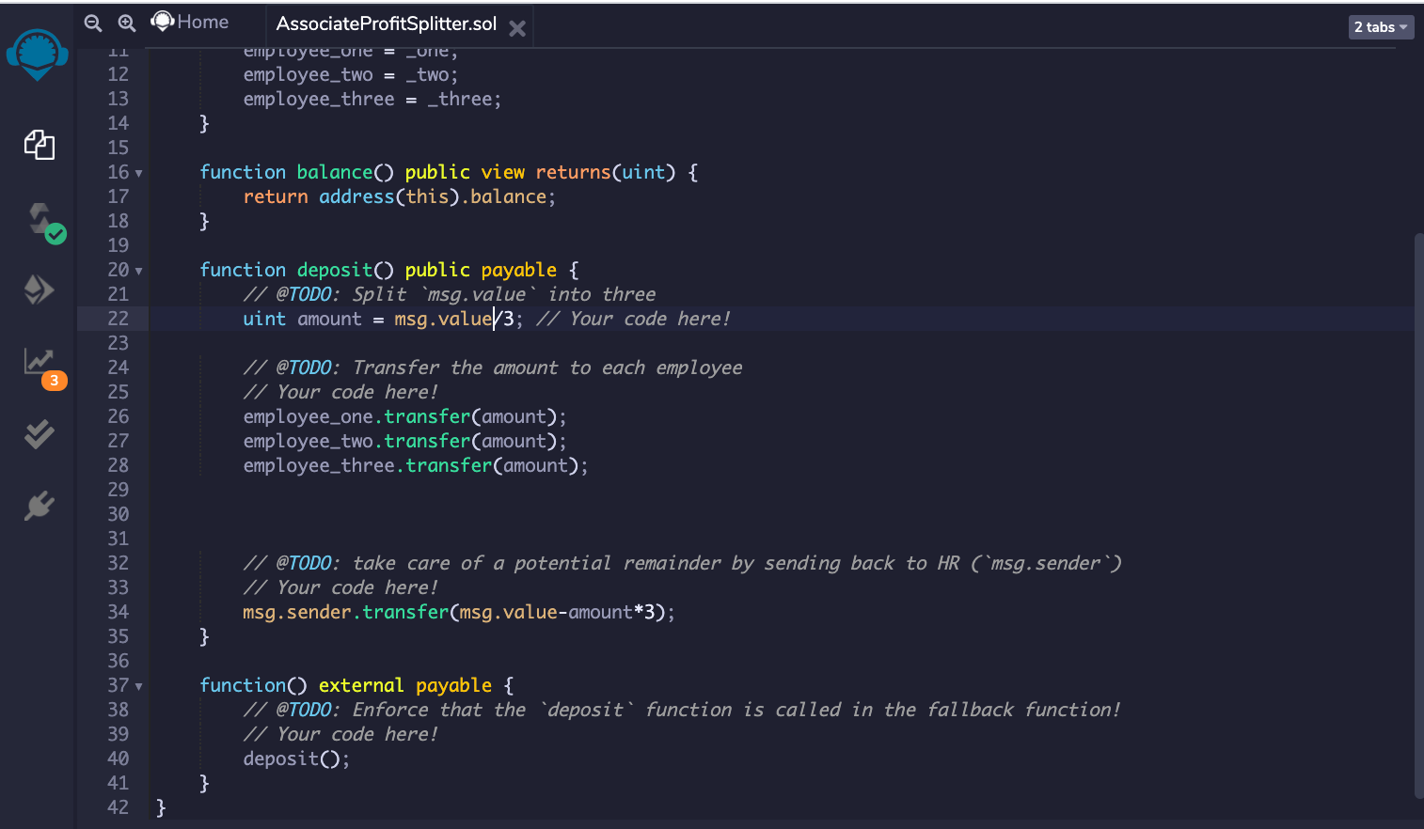
Create the first contract

Slide 3
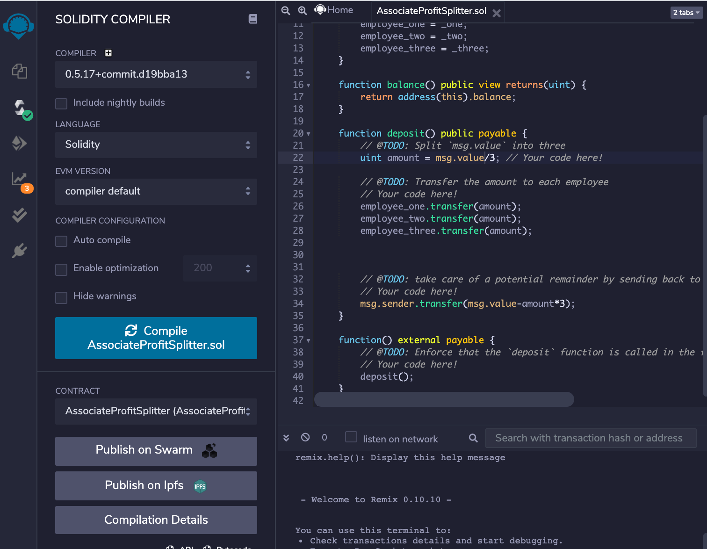
Compiling first contract

Slide 4
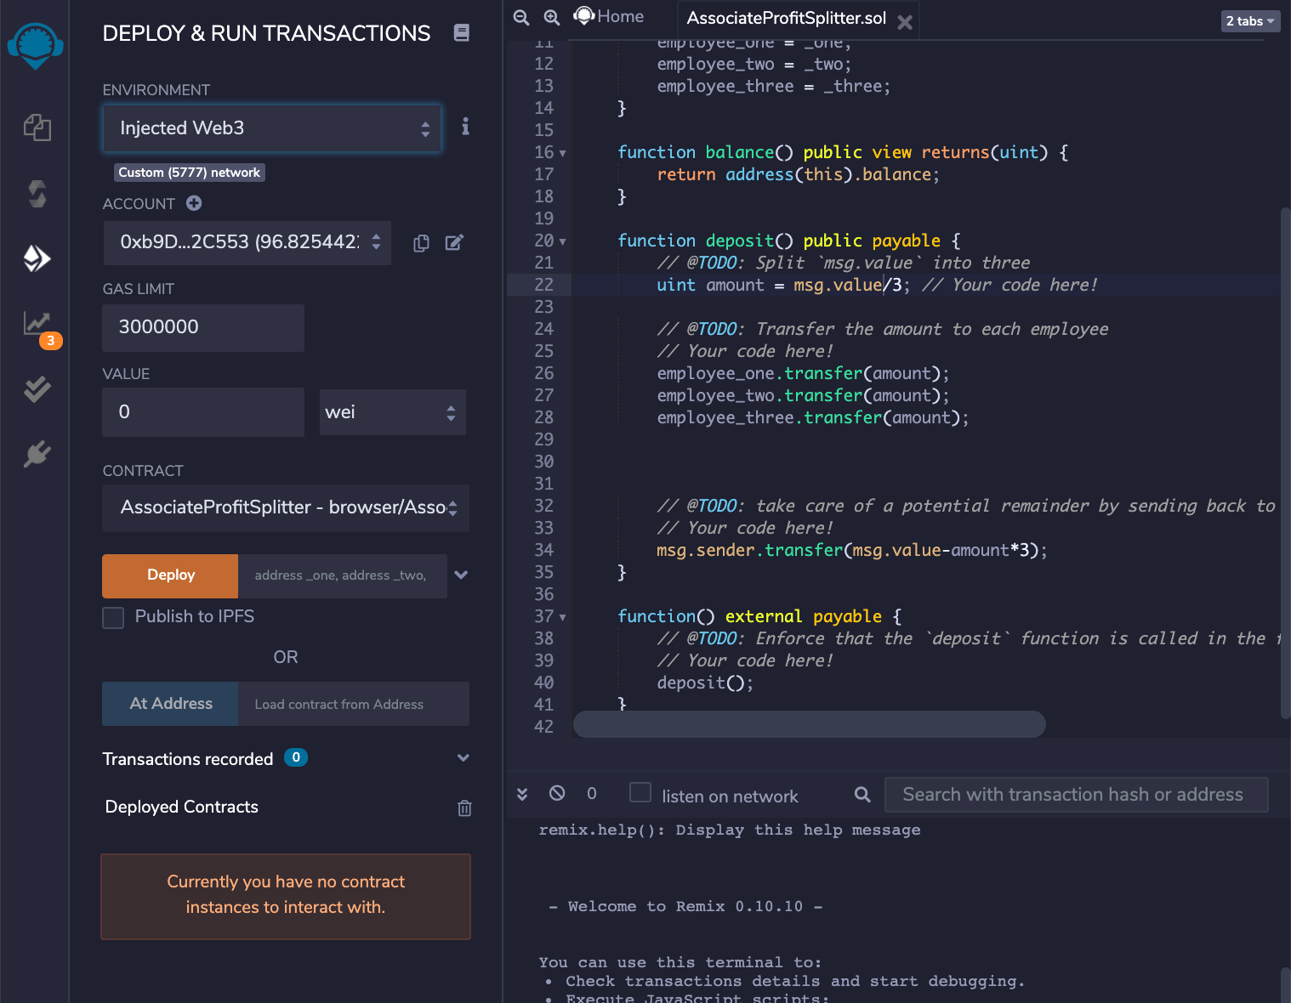
Deploy the first contract

Slide 5
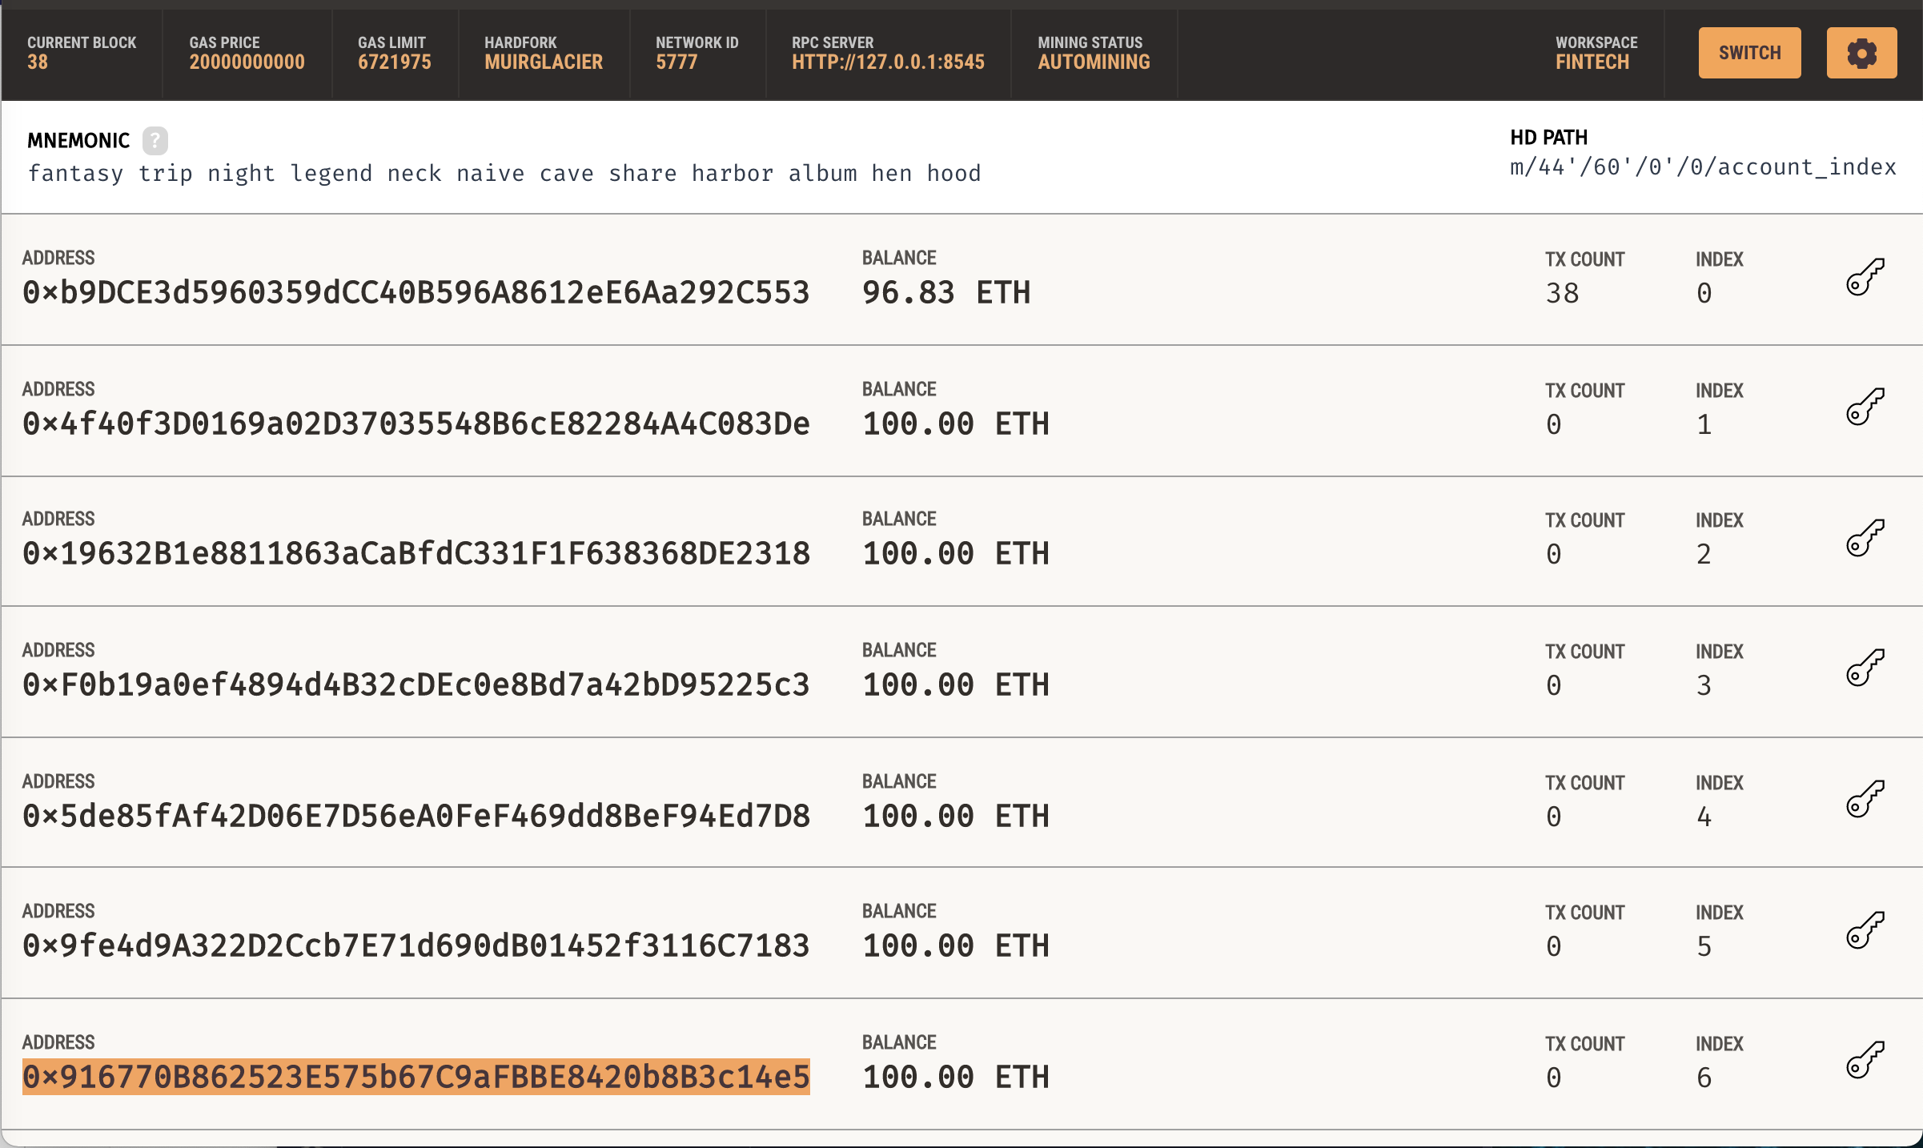
Addresses used for the Employees

Slide 6
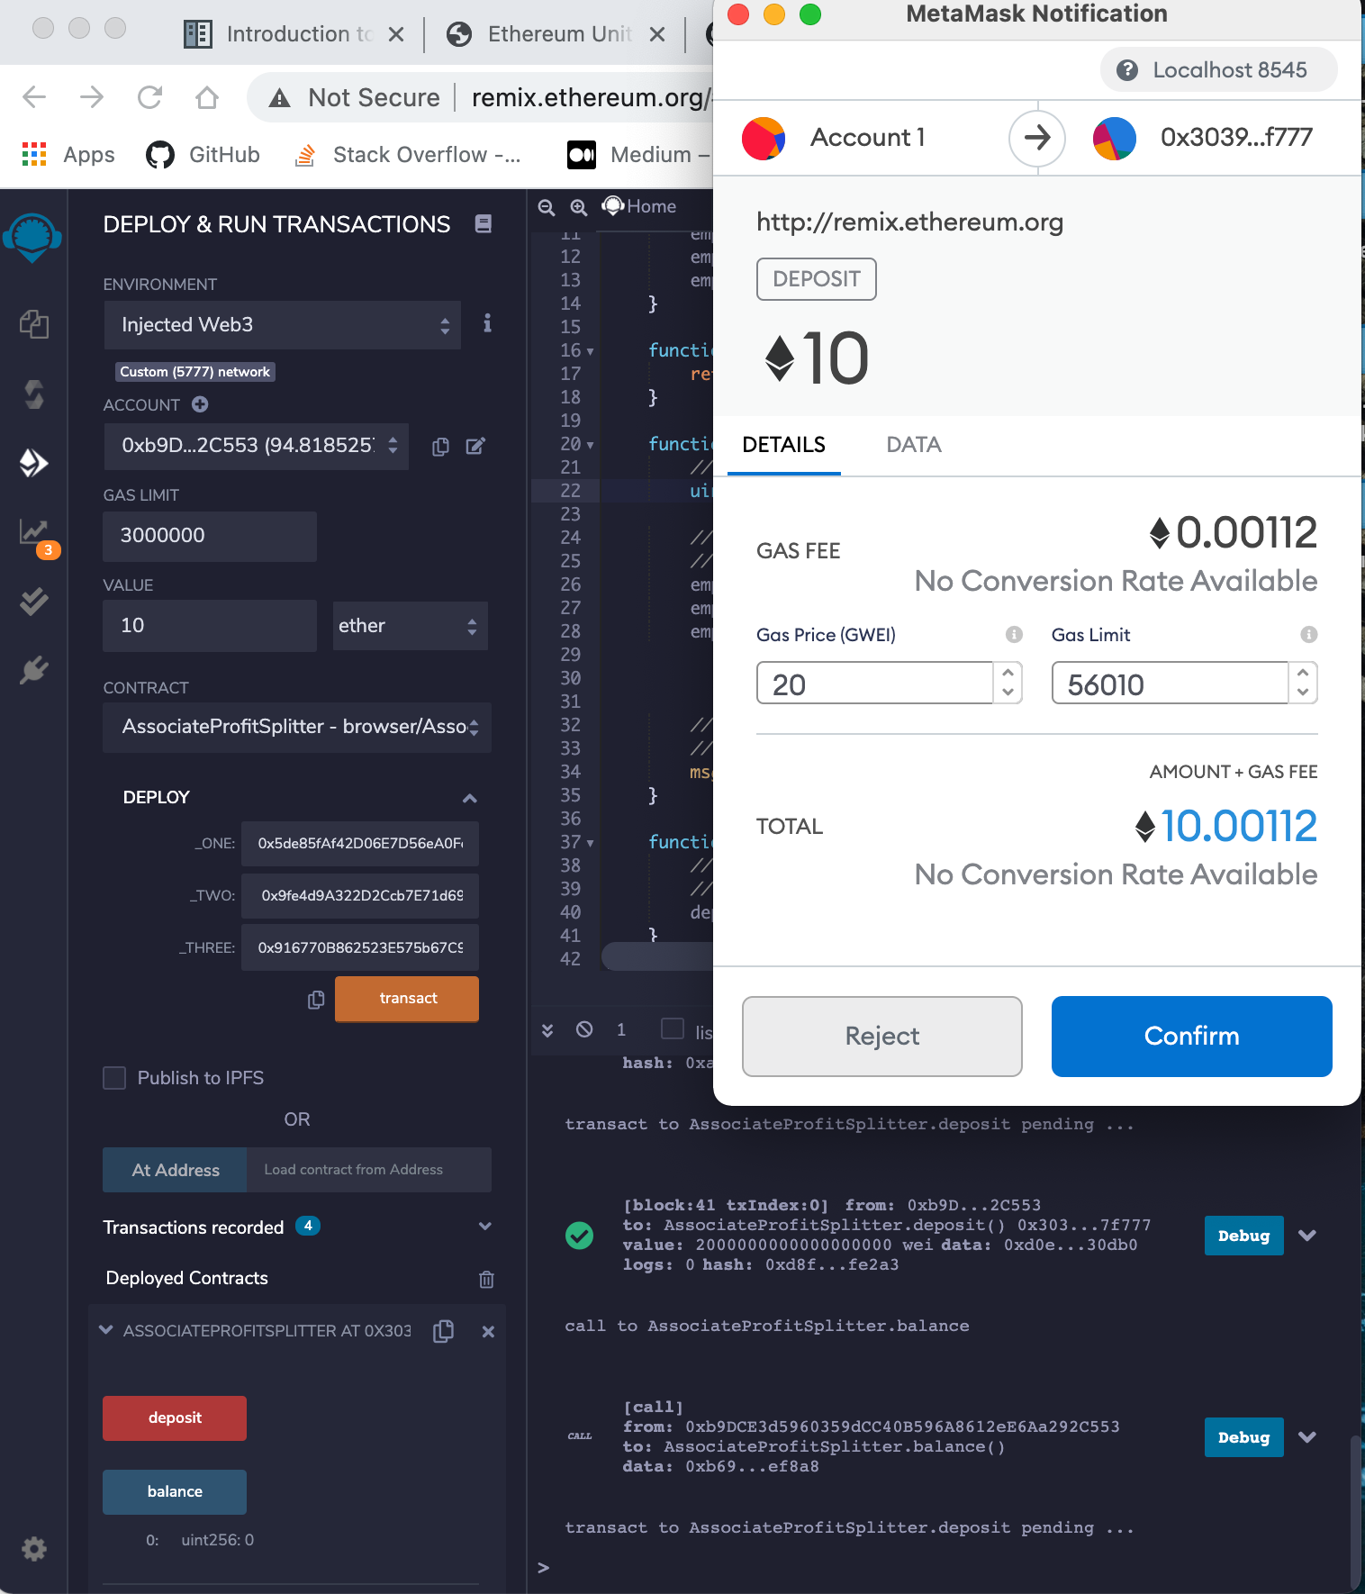
First transaction

Slide 7
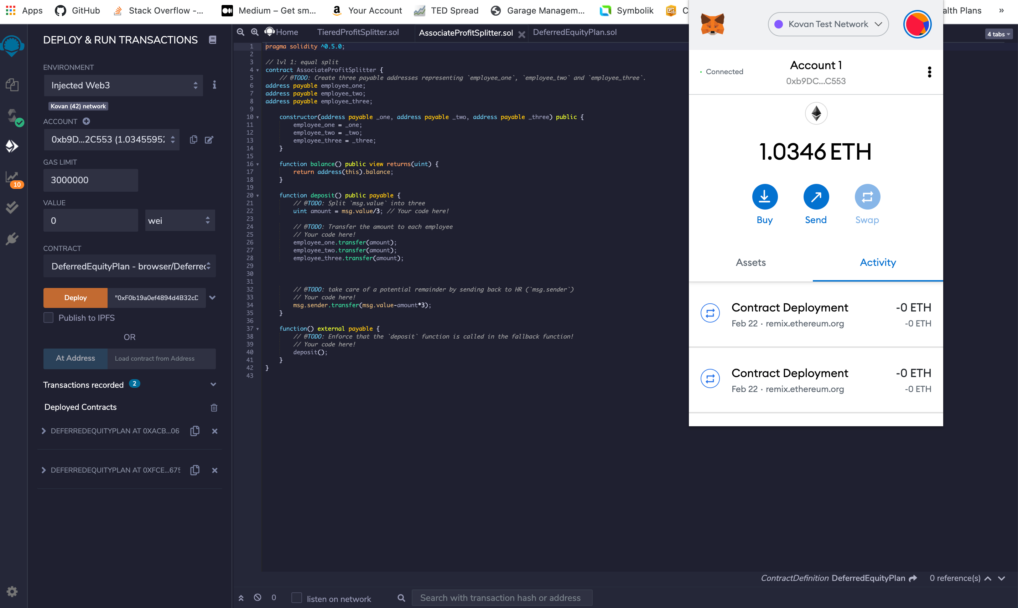
Deploy the first contract in live Tesnet

Slide 8
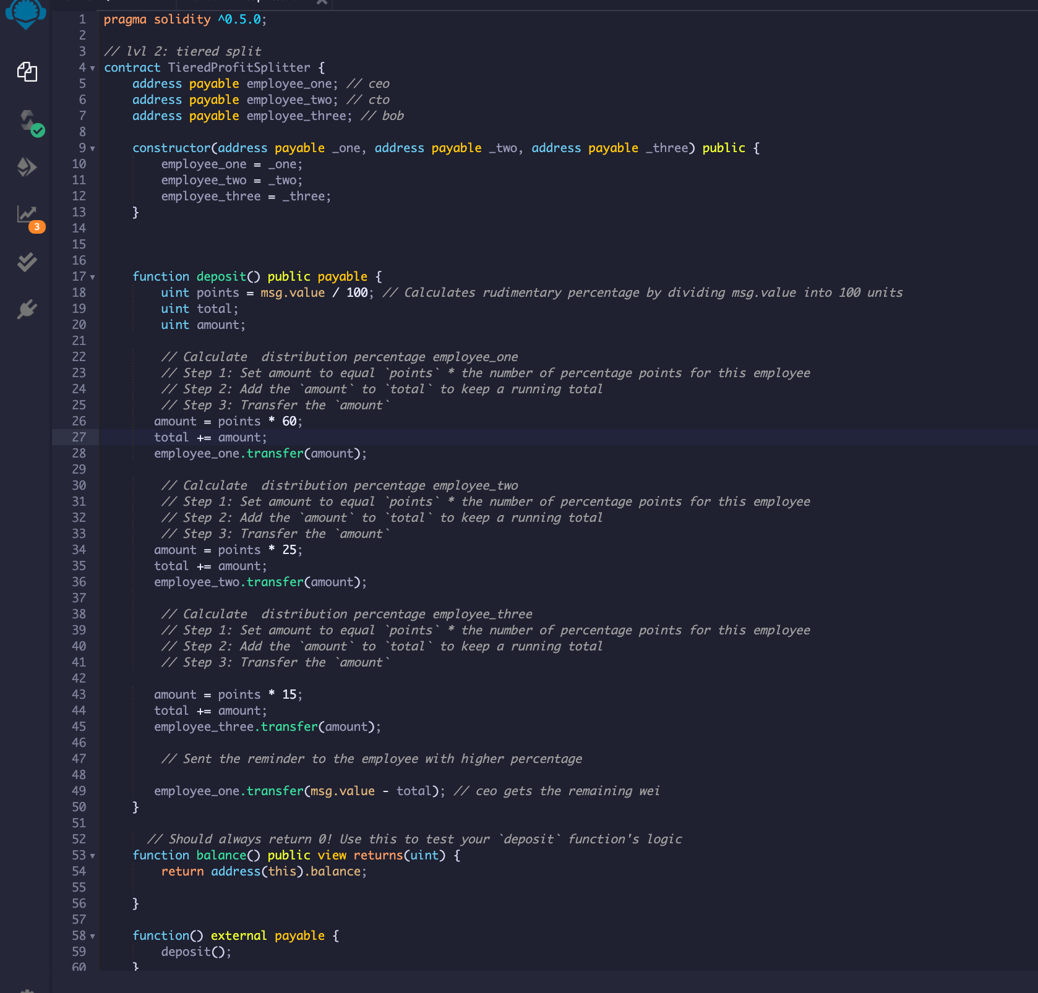
Create second contract

Slide 9
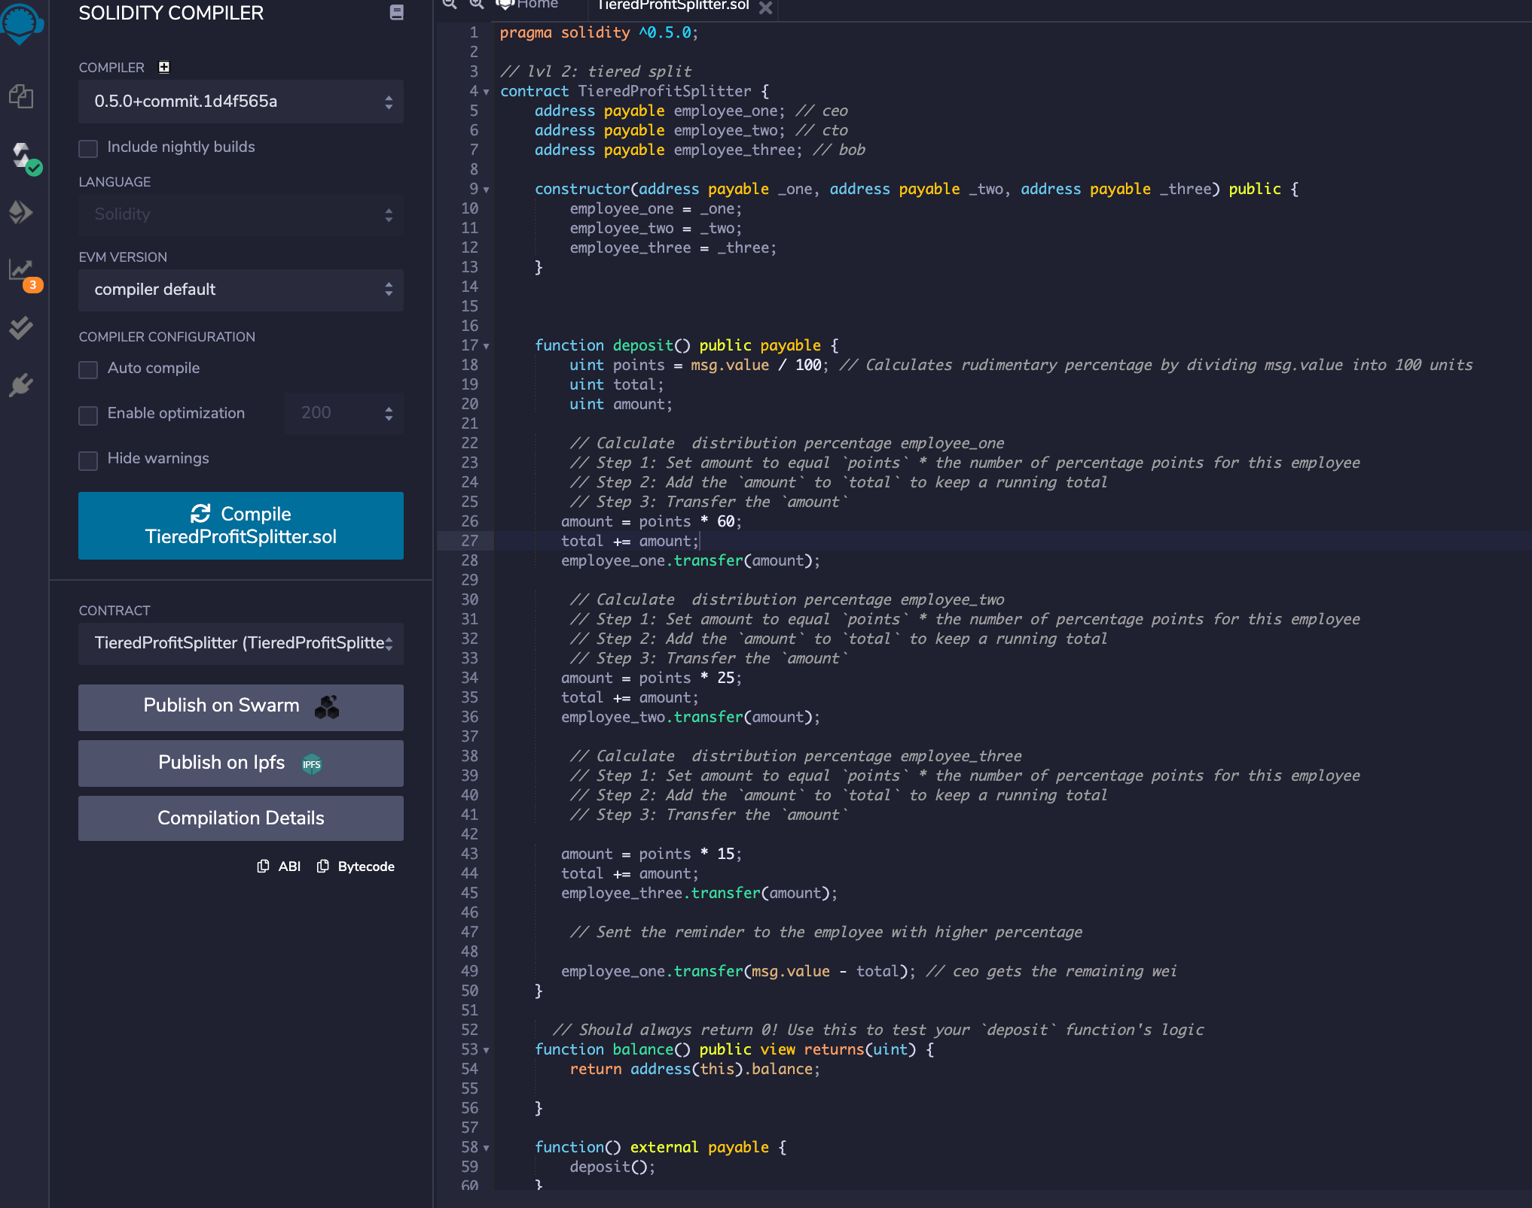
Compile second contract

Slide 10
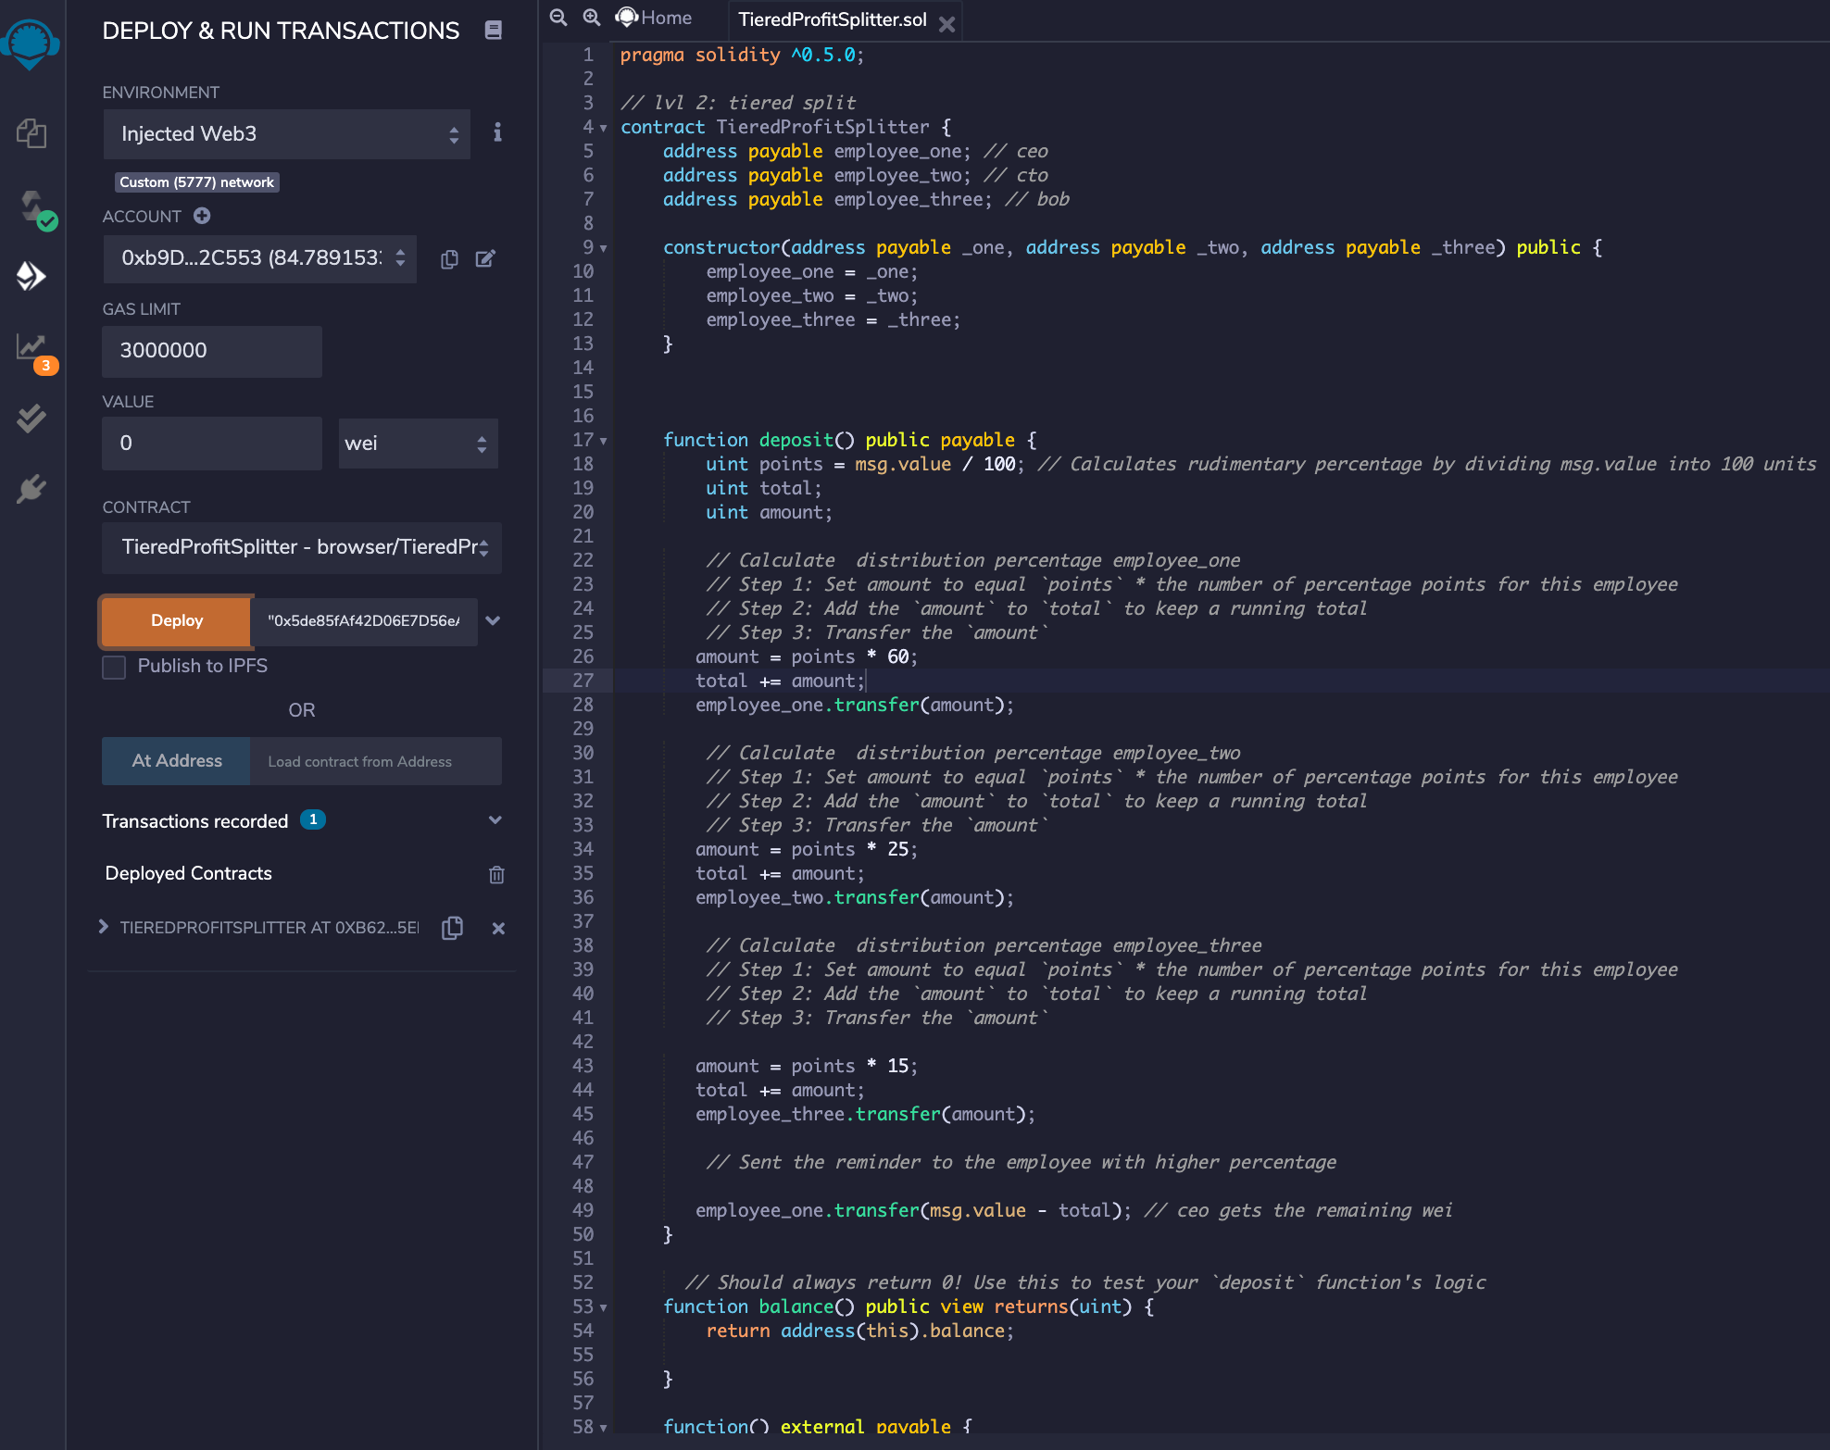
Deploy Second contract

Slide 11
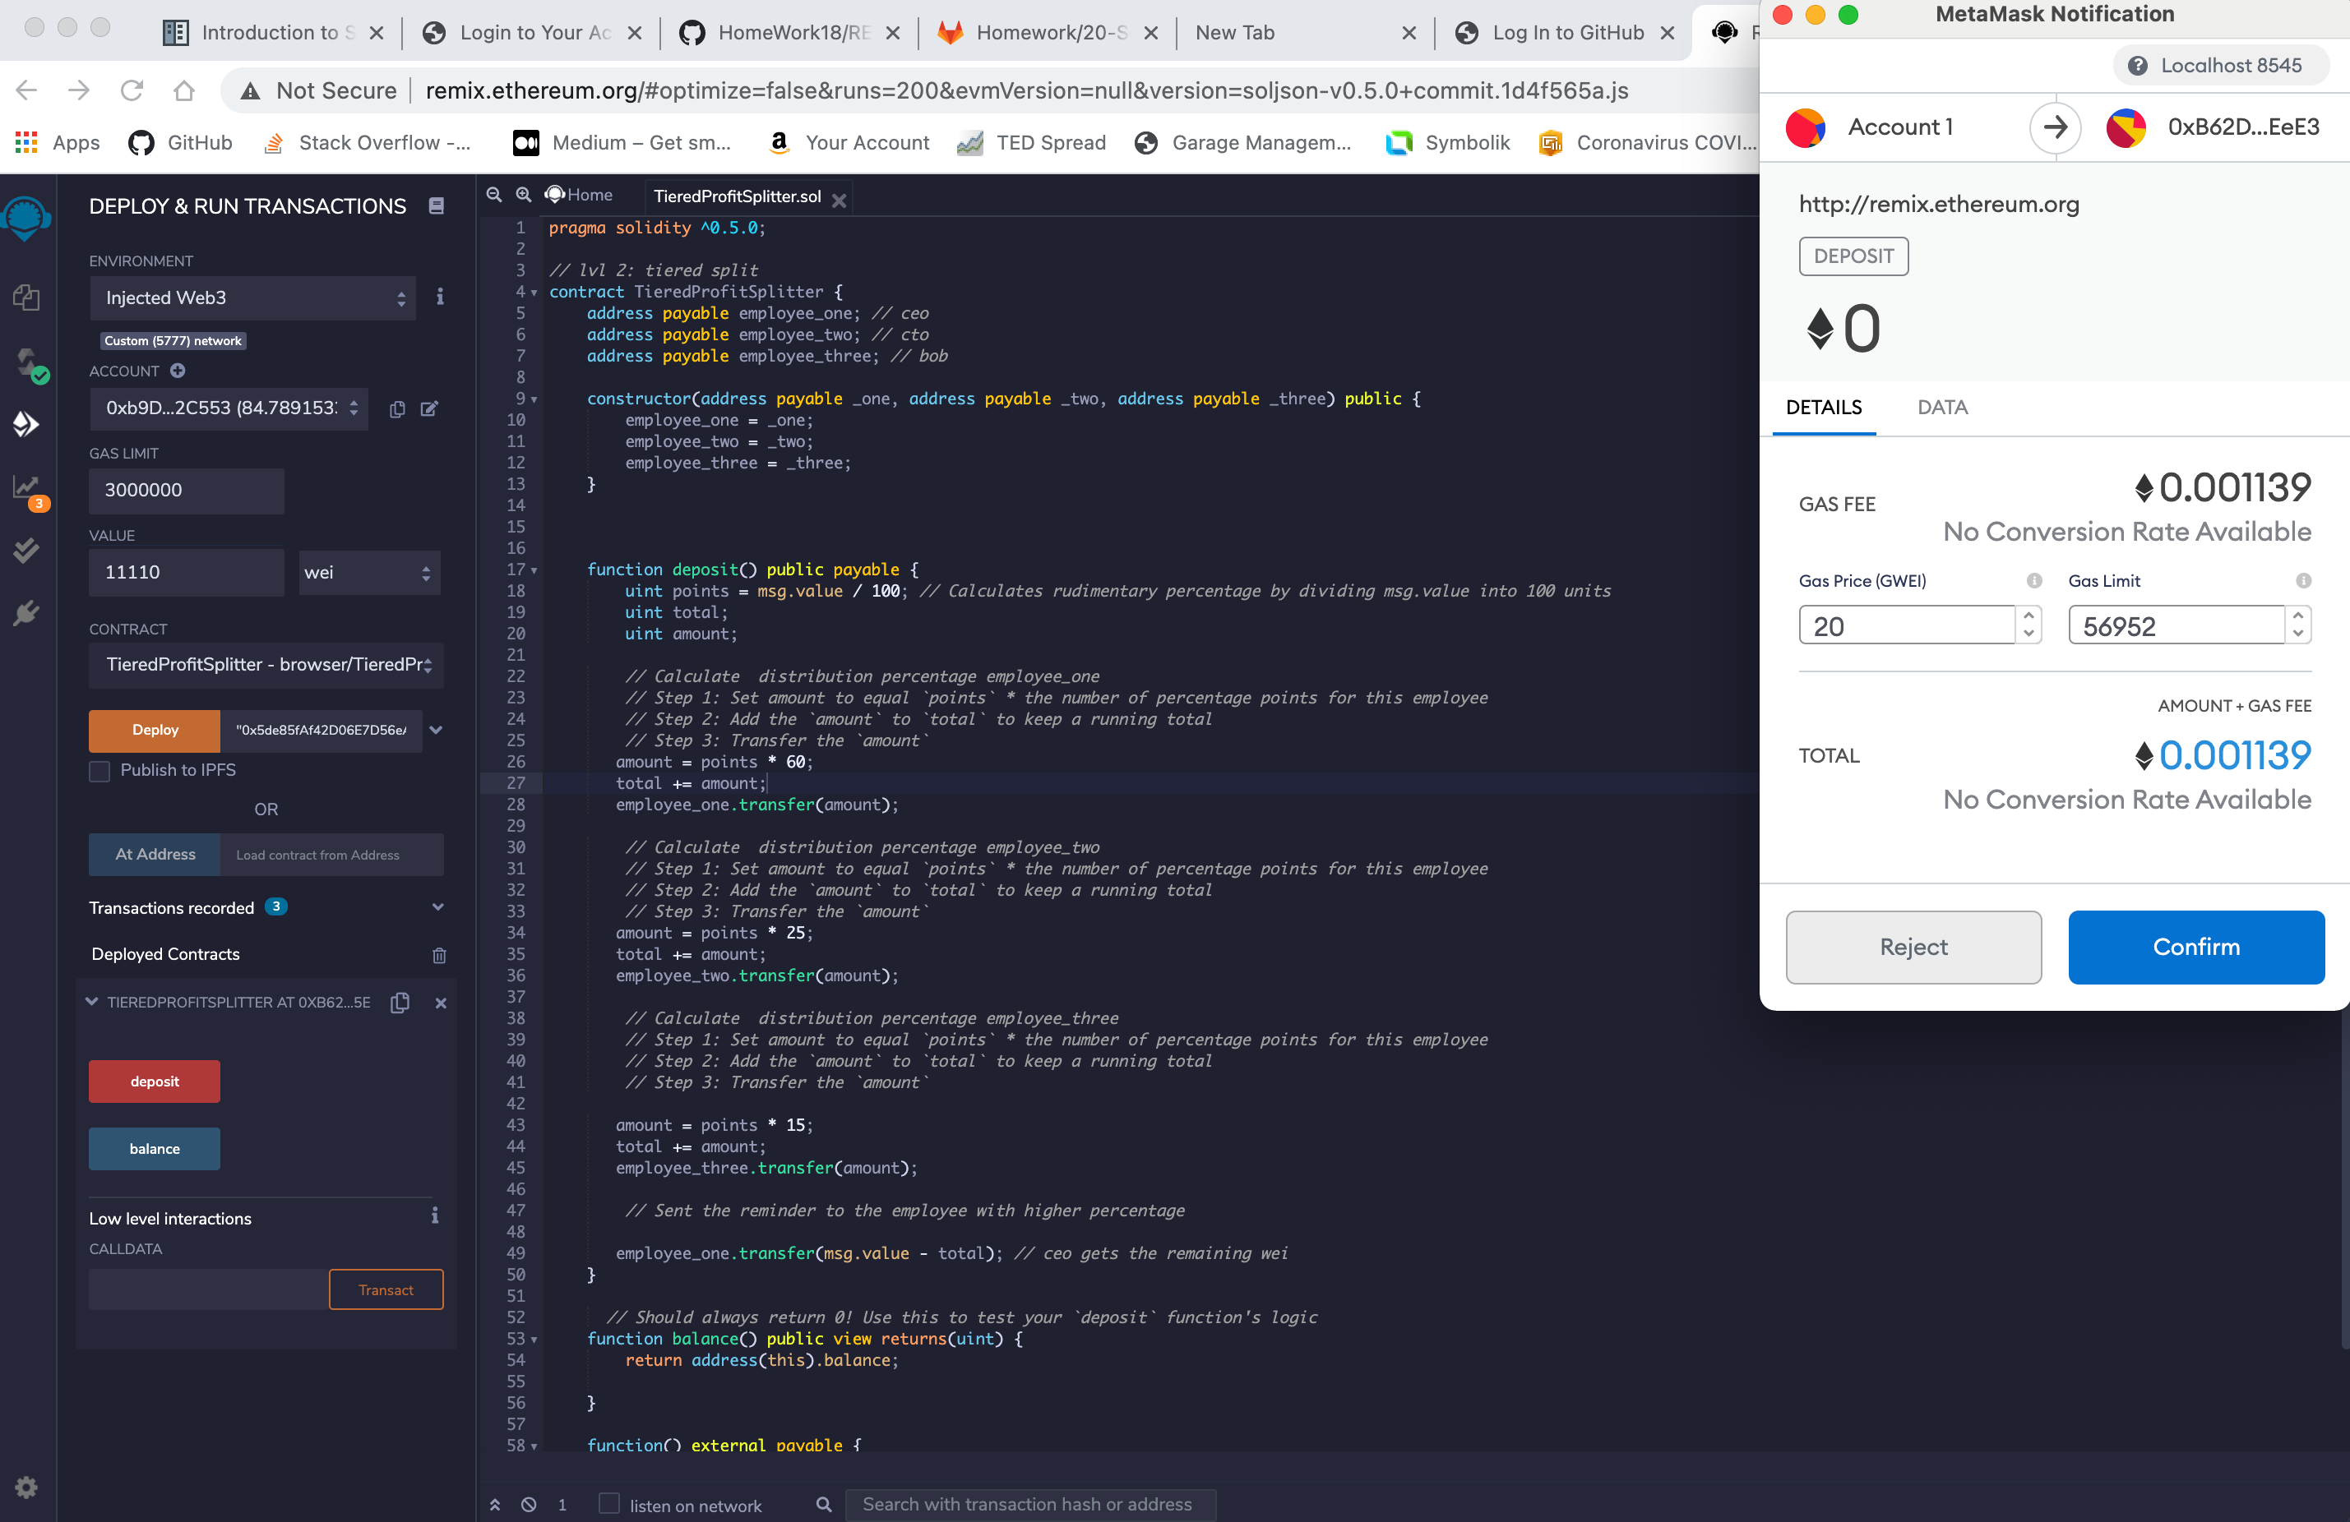
Test second contract

Slide 12
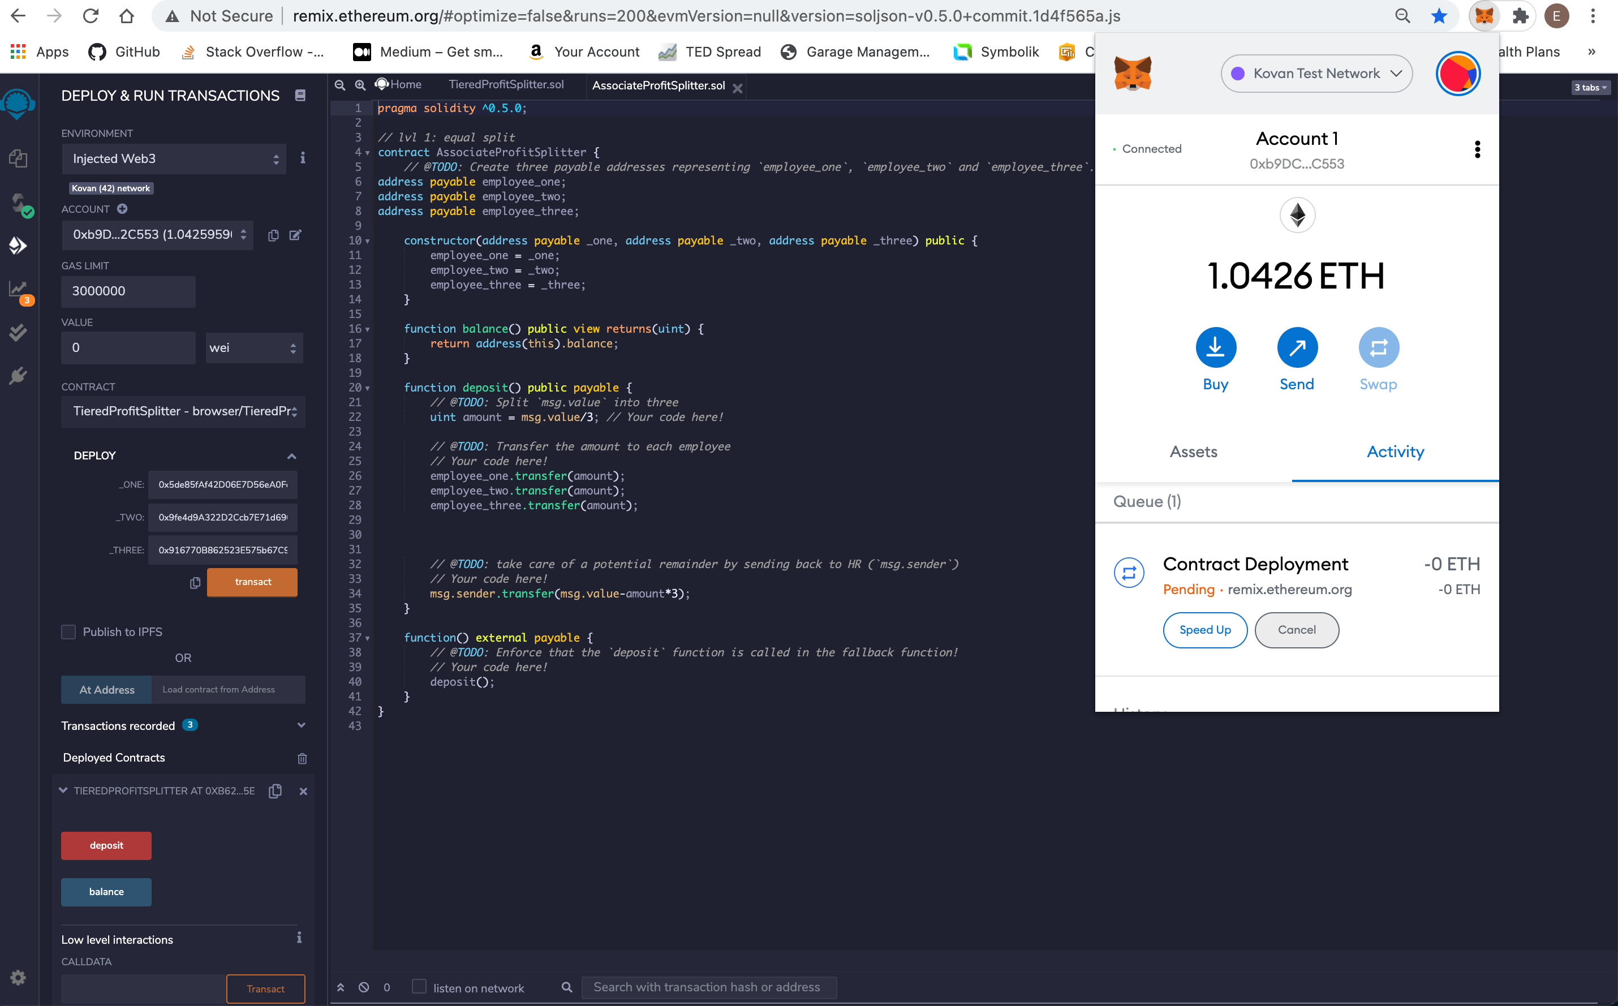
Deploy the the first contract in live Testnet

Slide 13
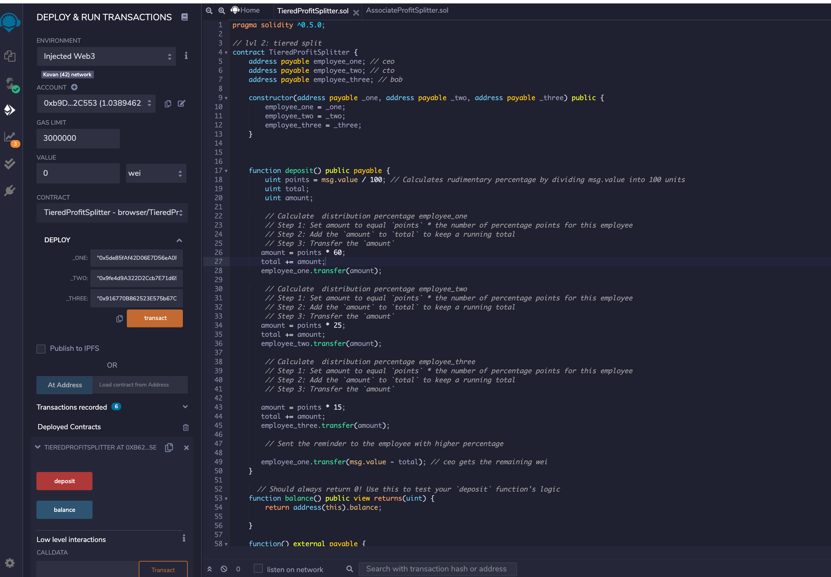
Deploy second contract in the live Testnet

Slide 14
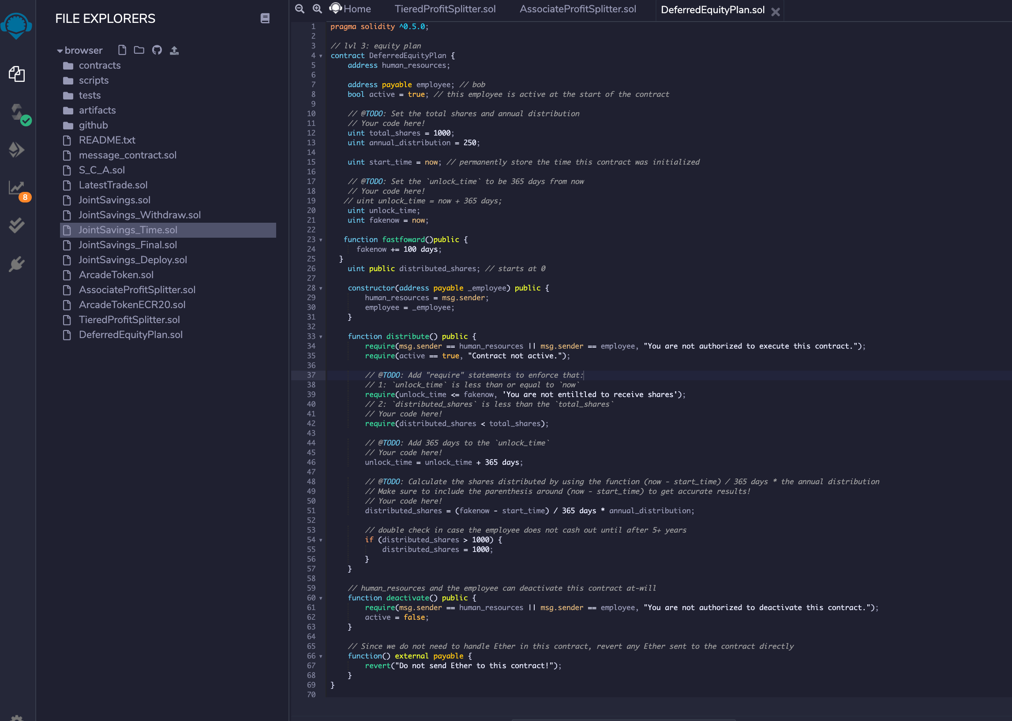
Create the third contract

Slide 15
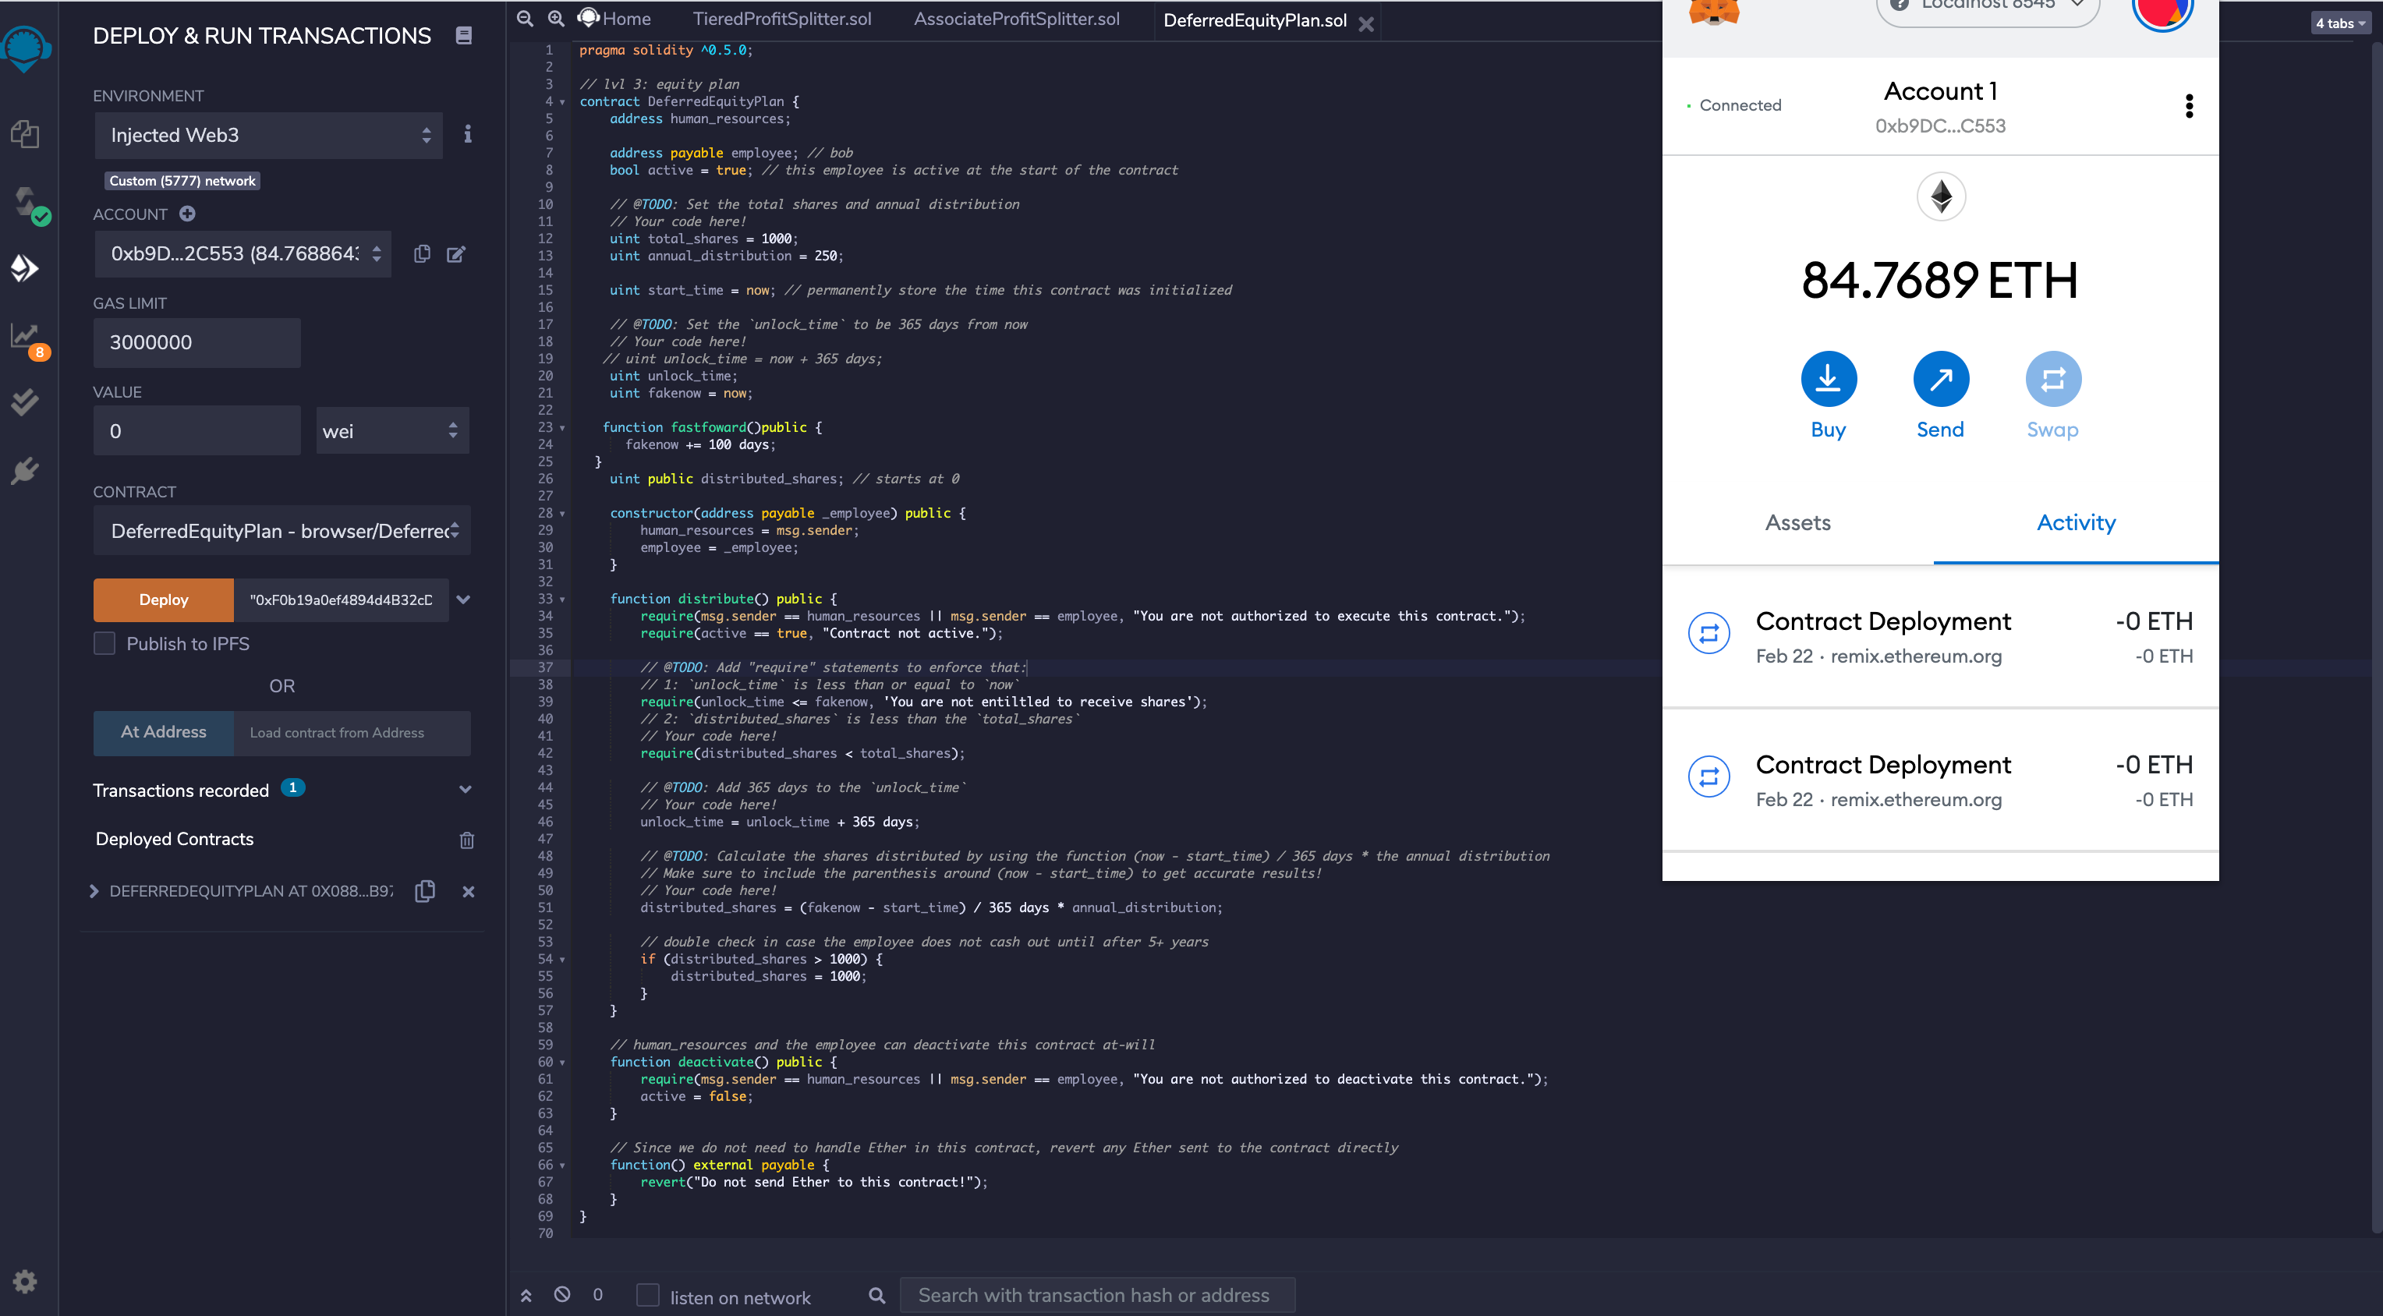
Compile the third contract

Slide 16
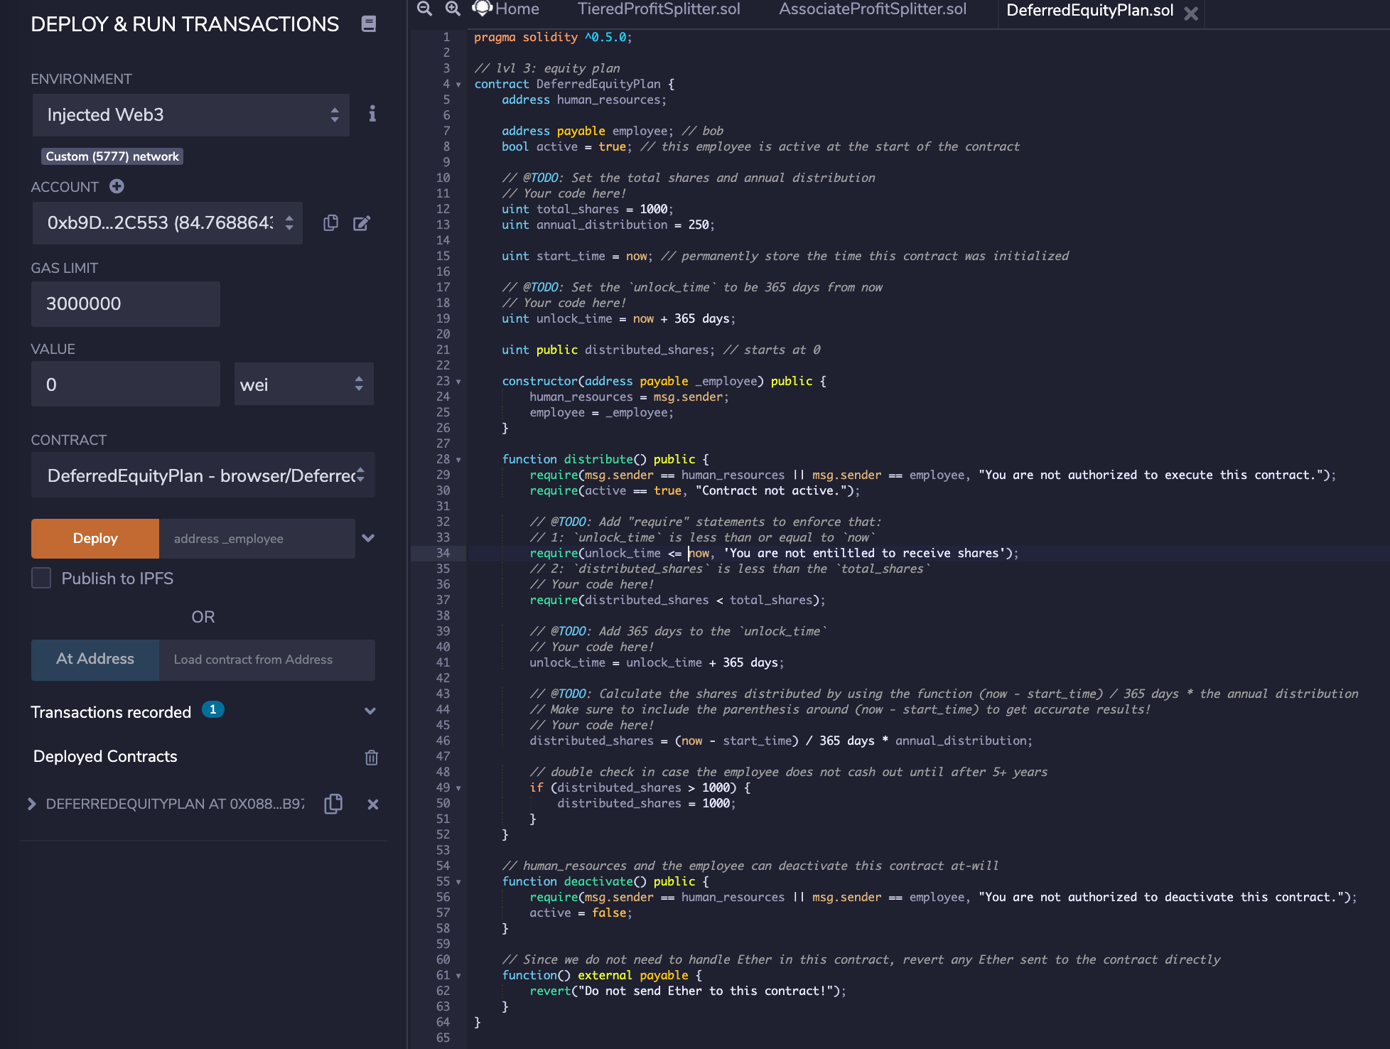
Deploy the third contract

Slide 17
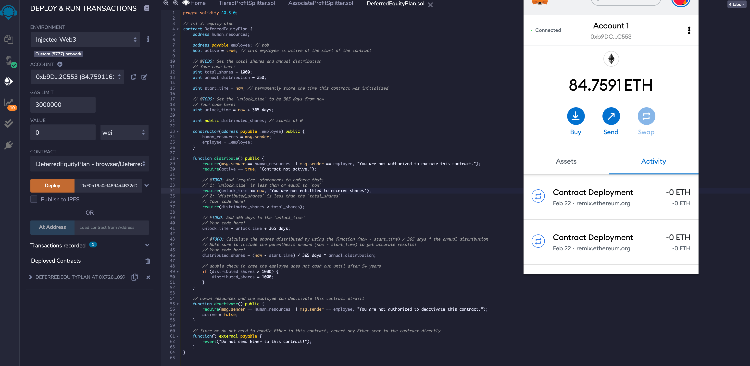
Test the third contract

Slide 18
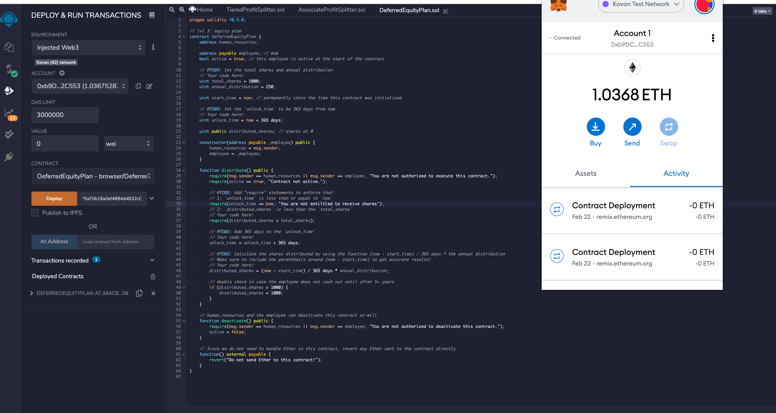
Deploy the Third Contract in live Tesnet

Slide 19
Copy the new addresses
0xB62DcFc3d9B5889cCbAf01d15a2EB81befF5EeE3
0xB62DcFc3d9B5889cCbAf01d15a2EB81befF5EeE3
0xACbbc4b7faC243eB95f1a12dFAd11E736E10613f

